Slide 1
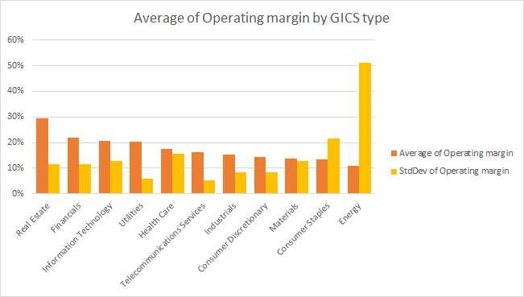
Average Operating Margin by GICS Type
Which GICS has the highest operating margin as presented by the data?
Real Estate with an average operating income of 29.32%, with a fairly low variability, 11.4% standard deviation. The standard deviation is generally higher with lower average operating income, as exampled by the Energy GICS, with an average operating income of 10.88% and a standard deviation of 51.21%

Slide 2
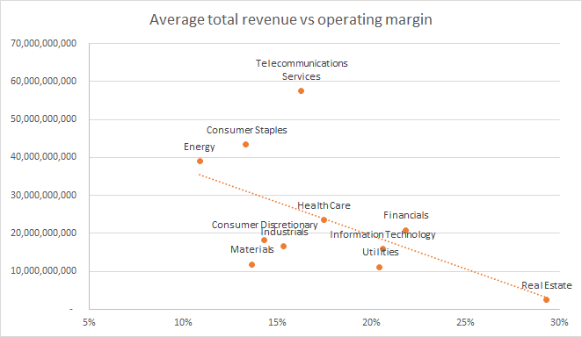
Average Operating Margin by GICS Type
What is the relationship between operating margins and total revenue?
As can be determined from the trendline, average total revenue is negatively correlated with average operating income. Real Estate with an average operating income of 29.32 on average only turns over 2.511 BN $. Turnover (average revenue) is generally higher with lower average operating income, as exampled by the Energy GICS, with an average operating income of 10.88% and an average revenue of 38.979 BN $.

